Slide 1


Fundamentals of RM
RM System and Process
Leadership in RM
Incident Investigation
RM Tools & Challenges
RM in Industry
People & Org.
Application and Perspectives
On Becoming a
Leader in Risk Management
ENGG404 - Lecture
Chapter 5.4:
Semi-Quantitative Risk Assessment (SQRA) and Its Integration in the RM Work Process

Slide 2
Learning Outcomes:
Explain the purpose of the Semi-Quantitative Risk Assessment (SQRA) Tool, a Risk Management tool, the manner in which it is used, and the benefits for planning work using the SQRA.
Demonstrate the integration of the SQRA (and similar Risk Assessment Tools such as FLRA, What-If Analysis) with the Risk Management Work Process and its tools (Matrix, Criteria Table, Management Directions), the RM System, and Control Measures.
Apply this tool as a rudimentary skill of leadership to observe, interact, commend, or intervene / coach employees in the work-place.
Chapter 5.4 Semi-Quantitative Risk Assessment and Its Integration
2
Notes:
2

Slide 3
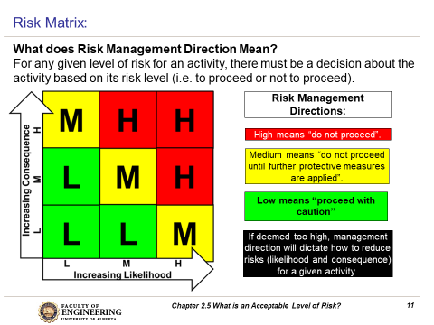
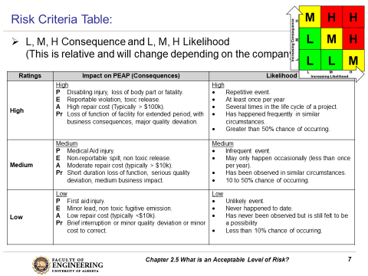
Use the Risk Matrix and Risk Criteria with the SQRA:
SEMI-QUANTITATVE RISK ASSESSMENT
Activity | Deviations and Concerns | Likelihood | Impact | Risk Level Before Control Measures | Control Measures | Likelihood with or after Control Measures | Impact with or after Control Measures | Risk Level After Control Measures | Proceed? Y/N
HIGH
LOW
Y
Chapter 5.4 Semi-Quantitative Risk Assessment and Its Integration
3
Notes:
3
Use your risk matrix and risk criteria table

Slide 4
Purposes and Applications of the SQRA:
Key purposes of the SQRA, and when it is applied:
It is used to assess hazards of an activity, job, or task, or installation or facility, to determine appropriate control measures in order to eliminate or control those hazards.
It is used during the planning stages of the activity, job, or task, or during the design and construction of the installation or facility.
It is used to ensure understanding of the control measures (to eliminate or mitigate the hazards) by the personnel preparing job plans, procedures, designs packages, and construction packages.
Chapter 5.4 Semi-Quantitative Risk Assessment and Its Integration
4
Notes:
4

Slide 5
The Basic Steps to Create an SQRA:
What are you doing?
What can go wrong?
What are you going to do about it?
Identify job and scope.
Determine key activities.
Identify deviations and concerns associated for each key activity.
Use the “What-If Analysis” to determine any deviations and concerns!
Determine likelihood, impact, and risk level posed by each deviation / concern without or before control measures.
Identify suitable control measures for each deviation / concern.
Determine likelihood, impact, and risk level posed with or after control measures.
Determine whether to proceed with the activity or not.
Incorporate or integrate the control measures in the job plan or engineering / design / construction package.
During or after the job plan is being executed, or after engineering / design / construction, determine the effectiveness of the control measures.
SEMI-QUANTITATVE RISK ASSESSMENT
Activity | Deviations and Concerns | Likelihood | Impact | Risk Level Before Control Measures | Control Measures | Likelihood with or after Control Measures | Impact with or after Control Measures | Risk Level After Control Measures | Proceed? Y/N
HIGH
LOW
Y
Chapter 5.4 Semi-Quantitative Risk Assessment and Its Integration
5
Notes:
5

Slide 6
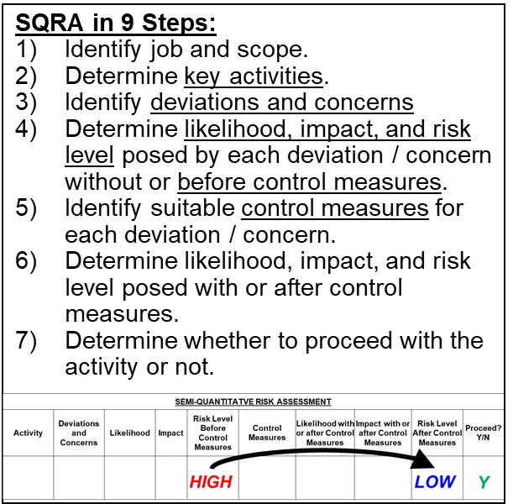
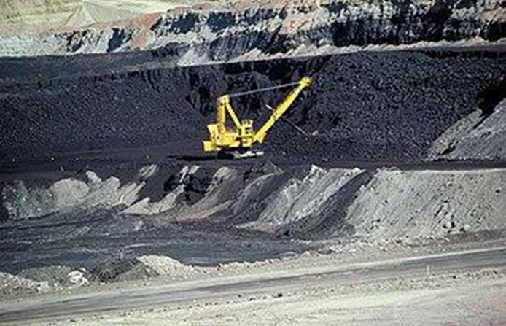
ALE #1: Apply the Semi-Quantitative Risk Assessment Tool:
Recall LI from Chapter 4.2 and 4.3. Please confer (Open discussion).
You are called to a scene where a mining haul truck and a shovel have been crushed with debris from an adjacent slope. You find one individual with a severe injury. You know the slopes are being monitored, you know there are procedures for safe work near the slopes, and you know it had been raining for the last week.
How could this incident have been
prevented using SQRA?
Apply the SQRA (nine steps) for this job activity:
“Operator operating within the exclusion zone”
Chapter 5.4 Semi-Quantitative Risk Assessment and Its Integration
6
Notes:
6

Slide 7
Example: Semi-Quantitative Risk Assessment:
Remember that a control measure is typically designed to result in a reduction of likelihood or a reduction I consequence, usually not both!
Activity | Deviation/ Concern | Likelihood | Conse-quence | Risk Before Control Measures | Control Measures / Safeguards | Likeli-hood After Control Measure | Conse-quence After Control Measure | Residual Risk After Control Measures
Operator operating within the exclusion zone | Debris from slope failure injures operator and damages machine | M (Occurs <1X per yr, observed at other facilities) | H (Disabling injury or loss of life) | H | Institute an auditory alarm trigger for the slope monitoring system | L (Occurs <1x in 10 yrs) | H (Disabling injury or loss of life) | M
From Risk Criteria Table
From Risk Criteria Table
From Risk Matrix
This CM reduces L
Operator operating within the exclusion zone | Debris from slope failure injures operator and damages machine | M (Occurs <1X per yr, observed at other facilities) | H (Disabling injury or loss of life) | H | Install protective metal cage around cab of machine | M (Occurs <1X per yr, observed at other facilities) | L (First Aid injury) | L
This CM reduces C
Chapter 5.4 Semi-Quantitative Risk Assessment and Its Integration
7
Notes:
7
Make sure to point out the difference between implementing control measures to decrease the likelihood versus those employed to decrease consequence
Also point out the fact that you can have a control measure that decreases the L, the C, or both
Speak to midterm exam question regarding training for workers on SOPs (preventing the degradation of safety systems) – will reduce the likelihood, but only to M because mgmt. would need to do inspections and follow up to decrease to L

Slide 8
Example: Semi-Quantitative Risk Assessment:
SEMI-QUANTITATVE RISK ASSESSMENT
Activity | Deviations and Concerns | Likelihood | Impact | Risk Level Before Control Measures | Control Measures | Likelihood with or after Control Measures | Impact with or after Control Measures | Risk Level After Control Measures | Proceed? Y/N
A Practical Application:
For each Activity, there may be one or more Deviations / Concerns.
Assess the Likelihood, Impact (Consequences), and Risk Before Control Measures are implemented.
Define (and implement) the Control Measures.
Assess the Likelihood with or after Control Measures have been implemented.
Assess the Impact with or after Control Measures have been implemented.
Determine the Risk Level with or after Control Measures have been implemented, sometimes called the Residual Risk.
Is this Residual Risk acceptable to Proceed?
In all cases, if the control measures are effective, then the residual risk level should decrease! If the control measures are NOT effective, then no change!
HIGH
LOW
Y
What are you doing?
What can go wrong?
What are you going to do about it?
Chapter 5.4 Semi-Quantitative Risk Assessment and Its Integration
8
Notes:
8

Slide 9
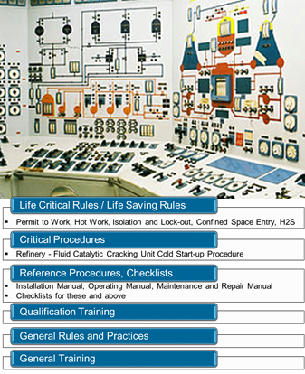
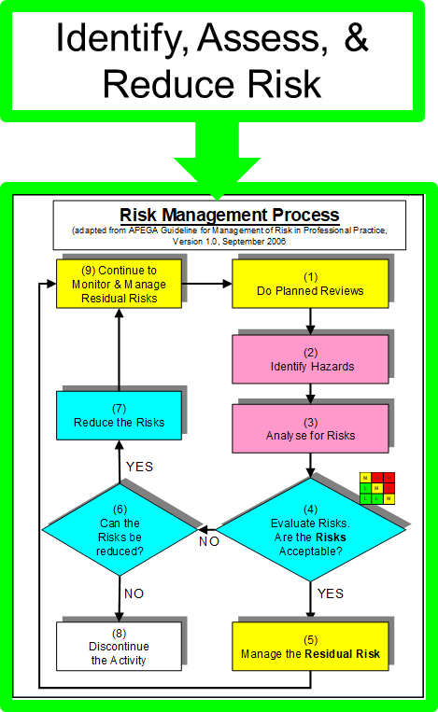
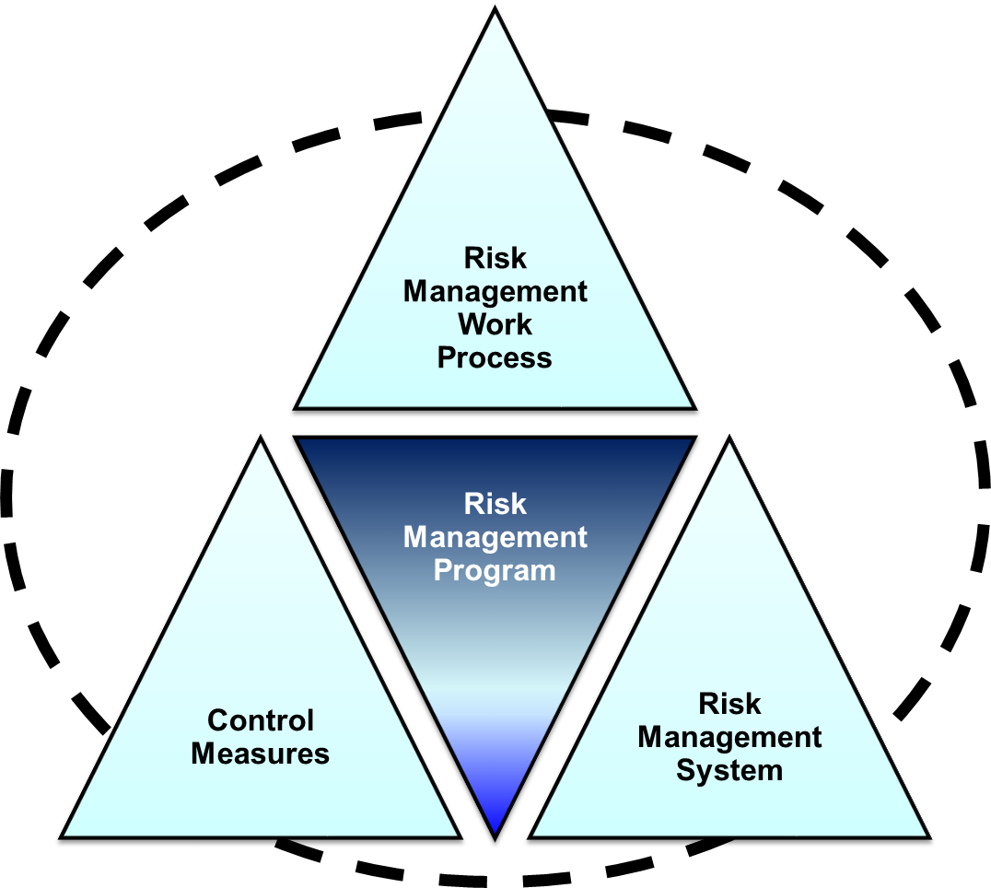
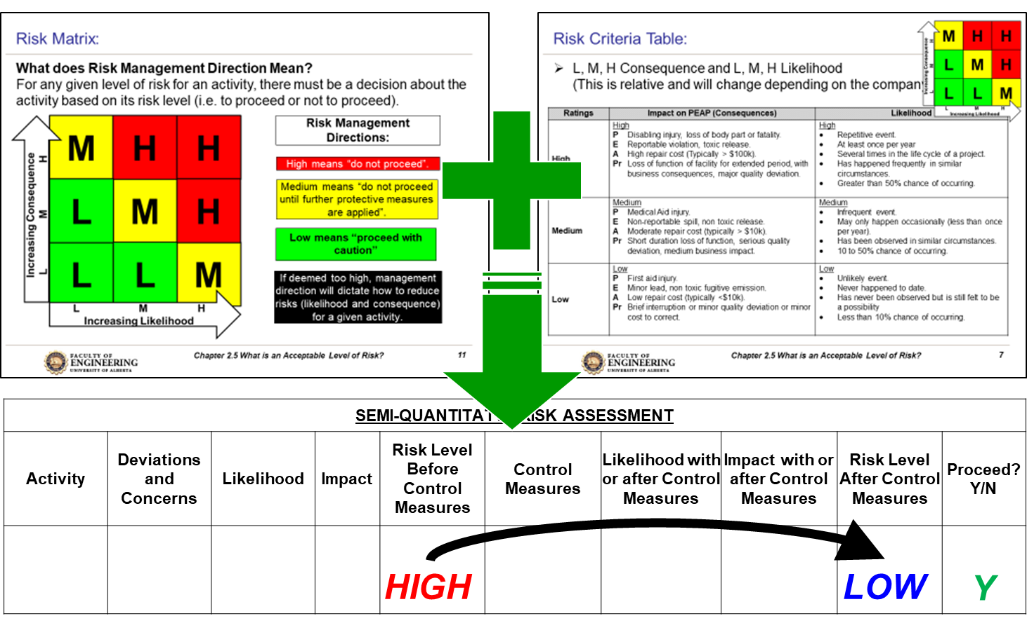
ALE #2: How are These Components Integrated?
Please confer and respond (Open discussion)
Topic #14
Topic #13
Today!
Chapter 5.4 Semi-Quantitative Risk Assessment and Its Integration
9
Notes:
9

Slide 10
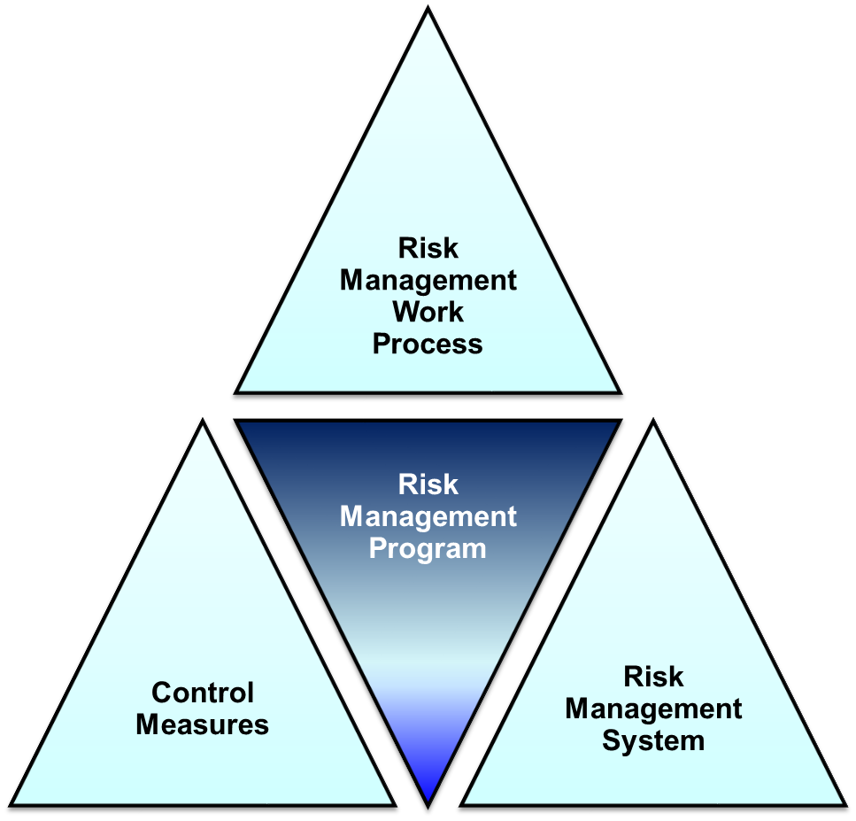
… Integration of The RM Work Process & Control Measures:
RM Work Process Function:
Analyzes risks to PEAP
Systematically assesses risks
opposite what is an acceptable level
RMWP uses tools such as:
Risk Matrices
Risk Criteria Tables
Management Directions
SQRA
      Control Measures:
      The SQRA is used to define and implement the CM’s to reduce and control risks to an acceptable level
RME #2 RA&MR
SQRA is a “standard”
Chapter 5.4 Semi-Quantitative Risk Assessment and Its Integration
10
Notes:
10

Slide 11
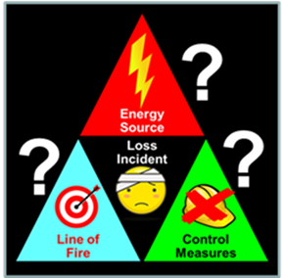
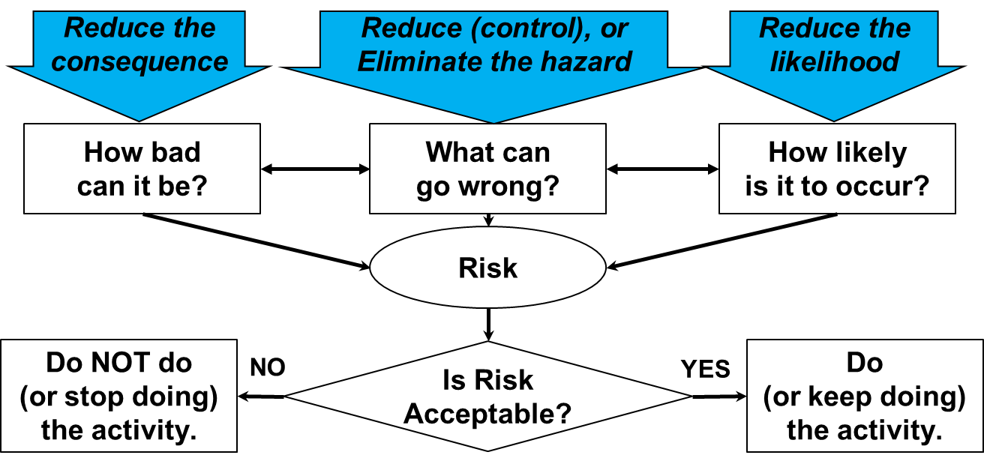
Integration of The RMWP, CM’s, & RA Tools:
RME #2 RA&MR
SQRA is a “standard”
Chapter 5.4 Semi-Quantitative Risk Assessment and Its Integration
11
Notes:
11

Slide 12
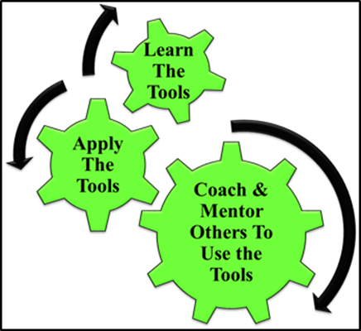
SQRA as a Leadership Tool:
Apply the SQRA to reduce risks to acceptable levels, and
Coach and mentor others in its effective use.
Chapter 5.4 Semi-Quantitative Risk Assessment and Its Integration
12
Notes:
12

Slide 13
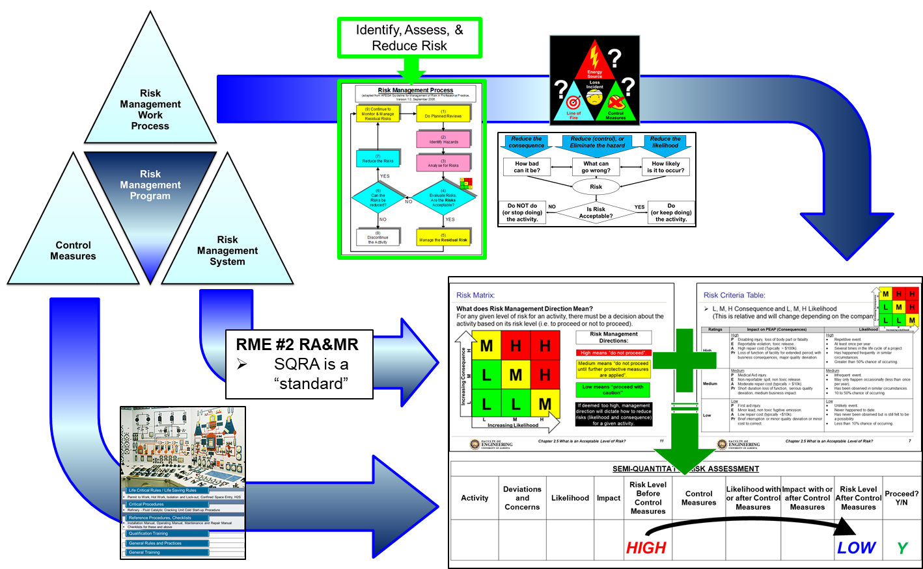
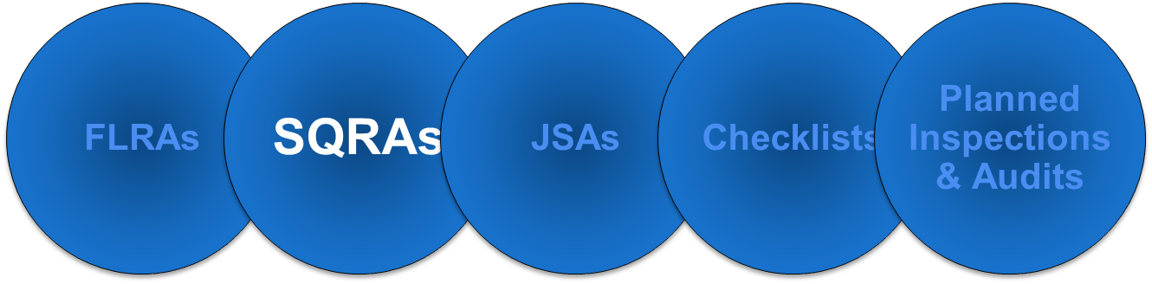
Summary and Key Lessons:
SQRA:
Used well in advance of and part of the planning process for work activities, or during the engineering / design / construction of installations and facilities.
One of many different risk assessment tool;
Systematically identifies hazards and specifies appropriate control measures.
Can be complemented with the application of incident models i.e. knowledge-based and discovery-based approaches for hazard identification.
Use your expertise to coach others!
Chapter 5.4 Semi-Quantitative Risk Assessment and Its Integration
13
Notes:
13

Slide 14
Any questions?
Notes:
14

